Slide 1
Giving shape to sustainability
Presentation 12 Jan 2021

Slide 2
Agenda
Overview
Introduction
Project
Guideline
CFP
Structure
Methodology
Fundamentals
System boundary
RF
Allocation
Guidance national assessments
Q&A

Slide 3
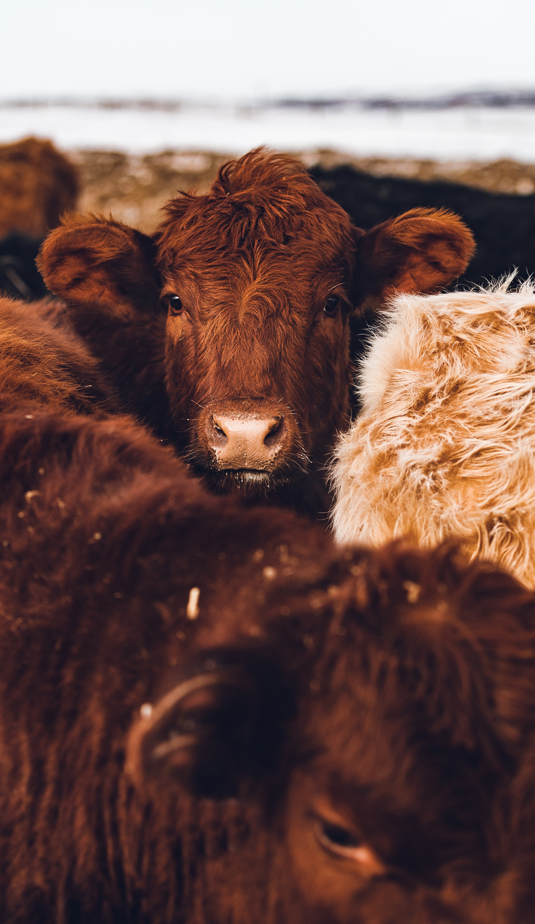
Introduction
GRSB CFP Guideline
Project
As part of a broader aim of GRSB to drive a more sustainable beef industry, need to calculate GHG emissions from beef cattle.
Calculate and monitor performance and actions for sector improvement.
Different guidelines/standards available, advising on different methods or open for practitioners’ interpretation.
To avoid inconsistencies, GRSB CFP guideline commissioned by GRSB.
Develop a common approach based on international standards and current best knowledge to address methodological challenges for CF with a life cycle perspective of beef cattle production.
Kick-off June 2021

Slide 4
Introduction
GRSB CFP Guideline
Guideline Purpose
The purpose of the GRSB guideline is to provide rules to ensure alignment and consistency among studies performed for the quantification of GHG emissions of beef cattle supply chains.
Intended to be used globally by all kinds of stakeholders in beef cattle : Livestock producers, supply chainpartners, advocates or policy makers.
Examples: National/regional assessments, scope 3 emission calculaitons, researchers.

Slide 5
Introduction
GRSB CFP Guideline
What the guideline does do?
Quantification of GHG emissions cradle to gate.
Allows hot-spot identification
Comparisons in context of same study
Allows for performance tracking
Consistency among studies & reproducibility

Slide 6
Introduction
GRSB CFP Guideline
What the guideline does NOT do?
Comparisons outside the context of same study (related to background data used).
Soil carbon sequestration not in scope.
Only product carbon footprint, does not allow for corporate calculations or reporting.

Slide 7
Introduction
Carbon Footprint
GHG’s can be emitted and removed throughout the life cycle of a product.
The quantifications of these GHG’s expressed in CO2 eq. is the CFP of a product.
Emissions are converted to CO2 eq. Using GWP.
GWP values from latest IPCC Assessment report
GRSB guideline uses GWP-100
Product carbon footprint (no corporate emission modelling or reporting)
Carbon offsetting not part of CFP
dLUC included and reported separately
Attributtional LCA approach
Notes:
GWP: The global warming potential (GWP) is an index measuring the radiative forcing following an emission of a unit mass of a given substance, accumulated over a chosen time horizon
Attributional LCA: Attributional LCAs focus on describing the environmentally relevant physical flows to and from the product or process; this is in contrast to consequential assessments, which describe how relevant environmental flows change in response to, for example, changes in demand.

Slide 8
Guideline structure
5 different sections
Chapter 1. Provides an introduction to the guideline purpose and application
Chapter 2. Gives practitioner guidance on how to set up their study
Chapter 3 Describes the data to be collected in order to compile the life cycle inventory and model emissions to calculate the CFP of beef cattle production. The inventory is described first for the foreground process which is the Animal Farm; then Feed and other farm inputs; last Slaughtering.
Chapter 4 Elaborates on the calculation of direct emissions coming from animal farm activities.
Chapter 5 Gives practitioners insight on best practice for reporting results from their LCA study.

Slide 9
Methodology
GRSB Fundamentals
GRSB CFP Guideline
ISO 14040/44/67
GHG protocol- Product
PEFCR
PAS 2050 & PAS2050-1
FAO LEAP
IDF- CF approach
IPCC
LCA/CFP
Emission modeling
Sector specific
Notes:
ISO 14040, 14044 and 14067 (ISO, 2006a, 2006b, 2013)
Publicly Available Specification PAS 2050:2011 & PAS 2050-1: 2012 (BSI, 2011, 2012)
Greenhouse Gas protocol – Product Life cycle Reporting Standard (WBCSD & WRI, 2011) World Business Council for Sustainable Development/ World resource institute.
FAO LEAP guidelines - Environmental performance of large ruminant supply chains (FAO LEAP, 2016)
FAO LEAP guidelines - Environmental performance of animal feeds supply chains (FAO LEAP, 2015)
IDF – A common carbon footprint approach for the dairy sector: Bulletin 479/2015 (International Dairy Federation, 2015)
Product Environmental Footprint Category Rules (PEFCR) guideline (Zampori & Pant, 2019)
PEFCR Feed for food producing animals (European Commission, 2020)
2019 Refinement to the IPCC 2006 Guidelines for National Greenhouse Gas Inventories (IPCC, 2019a)

Slide 10
Methodology
GRSB guideline
Life Cycle perspective (attributional)
Defined to support most types of beef cattle production.
Modelling of average activity for 1 calendar year
A steady state “equilibrium population” at the animal farm is assumed, practitioner shall include all animal classes and ages on average present in one calendar year period.
To ensure consistency, default system boundary, processes to be included and data to be collected in the LCI are defined in the guideline
Notes:
:Life cycle perspective: All inputs and outputs collected over the life cycle of the beef cattle.

Slide 11
Methodology
Waste
Emissions
Product flow
F T E
(F) Fertilizer, (T)Transport,
(E) Energy,(P) Pesticides
System boundary
F T E P
T E
T E
Upstream
Foreground (animal farms)
Downstream (processing)
Crop-based feed ingredients
Cow/calf breeding systems
1st Processing
Warm carcass
Deboning, cutting, packing
Animal-based feed ingredients
Beef fattening systems
Additives
By - products
Rendering
Replacement animals
Crop cultivation
Dairy systems
Manure
System boundary (option 1 )
Milk

Slide 12
Methodology
Waste
Emissions
Product flow
F T E
(F) Fertilizer, (T)Transport,
(E) Energy,(P) Pesticides
System boundary
F T E P
T E
T E
Upstream
Foreground (animal farms)
Downstream (processing)
Crop-based feed ingredients
Cow/calf breeding systems
1st Processing
Warm carcass
Deboning, cutting, packing
Animal-based feed ingredients
Beef fattening systems
Additives
By - products
Rendering
Replacement animals
Crop cultivation
Dairy systems
Manure
System boundary (option 1 )
System boundary (option 2 )
Milk

Slide 13
Methodology
Reference flow
What ?
Quantitative measure of the output of a system required for a given functionality.
Inventory is modelled and results are provided on basis of this reference flow.
How?
Based on the defined sytem boundary:
Option 1: 1 kg live weight at farm gate (Sytem boundary option 1)
Option 2: 1 kg warm carcass after 1st processing (System boundary option 2)

Slide 14
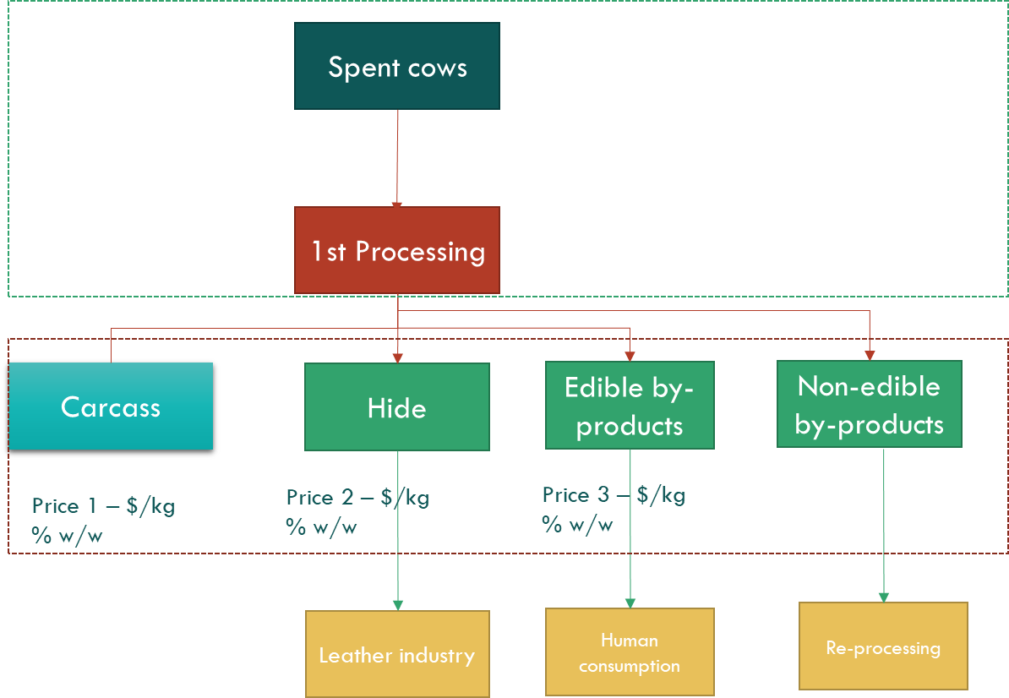
Methodology
Allocation
Allocation refers to the partitioning of the inputs or outputs of a process or product system between the product system under study and one or more other product systems.
Notes:
ISO recommendations →Avoiding allocation// system expansion// physical relations// other relationships.
Before last point→ Allocation methods reflect value choices. Such value choices can influence LCA results and the conclusions of LCA studies.
Method to be implemented was carefully considered in developing this guideline.
Best method is proposed as default. As this will affect results and main objective is consistency among studies.
Other methods are allowed (not described) as part of the interpretation of results.

Slide 15
Upstream
Spent cows
1st Processing
Carcass
Hide
Edible by-products
Non-edible by-products
Price 1 – $/kg
% w/w
Price 2 – $/kg
% w/w
Price 3 – $/kg
% w/w
Price 4 – $/kg
% w/w
Total revenue
Leather industry
Human consumption
Re-processing

Slide 16
Methodology
Allocation
Allocation refers to the partitioning of the inputs or outputs of a process or product system between the product system under study and one or more other product systems.
ISO 14040/44 recommendations on allocation.
Different processes/different allocation method may be found appropriate.
Method should reflect the reality and drivers of the activity and its relation to the associated carbon footprint.
Data needs can vary among methods, which can have an influence on the applicability.
Most appropriate methods suggested as default in guideline.
Notes:
ISO recommendations →Avoiding allocation// system expansion// physical relations// other relationships.
Before last point→ Allocation methods reflect value choices. Such value choices can influence LCA results and the conclusions of LCA studies.
Method to be implemented was carefully considered in developing this guideline.
Best method is proposed as default. As this will affect results and main objective is consistency among studies.
Other methods are allowed (not described) as part of the interpretation of results.

Slide 17
Methodology
Allocation- Most relevant cases
Different outputs of animal farm require allocation
Biophysical
Animal farm
Milk
Spent cows
Calves
Dairy industry
Slaughtering
Backgrounding//Fattening
Mass
Notes:
Several instances/processes in the life cycle allocation is required. In this presentation I focus on the most relevant for the beef cattle system
Animal and milk: IDF Biophysical allocation
MASS ALLOCATION Animals- Mass allocation was chosen as default. This method will account for the live weight gain of the whole system, therefore all mass produced at farm is considered equal in this approach

Slide 18
Methodology
Allocation- Most relevant cases
Animal farm
Manure applied on farm
Animal products
Manure
Allocation required
Manure exported
Cut-off (residual approach)
Notes:
Residual approach: The GRSB guideline considers the residual approach for allocation, where system is cut-off, and no burden is carried to downstream of manure. Residual approach was found most practical to implement in any beef-cattle system, compared to less well-developed allocation options. (biophysical allocation, price shadow allocation).

Slide 19
Methodology
Allocation- Most relevant cases
Spent cows
Different outputs of 1rst processing require allocation
1st Processing
Carcass
Hide
Edible by-products
Non-edible by-products
Waste
Loss from evaporation
Leather industry
Human consumption
Re-processing
Economic allocation
Notes:
Default chosen as believed to best attribute the environmental impact of slaughter by-products based on those who “drive” the economic activity of the slaughterhouse, rather than considering all by-products the same (by mass).

Slide 20
Methodology
Emmissions (on farm)
The emissions that shall be modeled are the following:
• Methane (CH4) from enteric fermentation;
• Methane (CH4) from manure management;
• Direct nitrous oxide (N2O) from manure management;
• Indirect nitrous oxide (N2O) from leaching of manure;
• Indirect nitrous oxide (N2O) from volatilization of ammonia (NH3) and nitrogen oxides (NOx);
Emissions of each GHG to be reported separately.
Calculation aid provided (.xls)
Notes:
Apart from upstream and downstream emissions

Slide 21
GRSB guideline
Additional guidance
Appendix on additional guidance on how to perform studies at National level.
Complementary to Section 3.0 Inventory data collection.
Aids practitioners on “where to start?” when performing at a country level.
Step-wise (iterative) approach:
Goal and scope definition
Complete mapping of population/ definition of sub-populations
Identifying available data (reliabel and representative)
Sampling (when needed)
Supply chain considerations, similar to national level. Differences in available data sources, often sampling is required.

Slide 22
GRSB guideline
Summary
Guideline is a common approach based on international standards and current best knowledge for beef cattle carbon footprinting.
Allignment in relevant methodological aspects:
Reference flow
System boundary
Allocation
Instructions and assistance for:
Life cycle inventory data collection
Calculate on farm GHG emissions
Report results
How to conduct national/supply chain assessments

Slide 23
Questions?

Slide 24
Thank you!

