Slide 1
SARRSB
National Round Table Update on IFAD Project

Slide 2
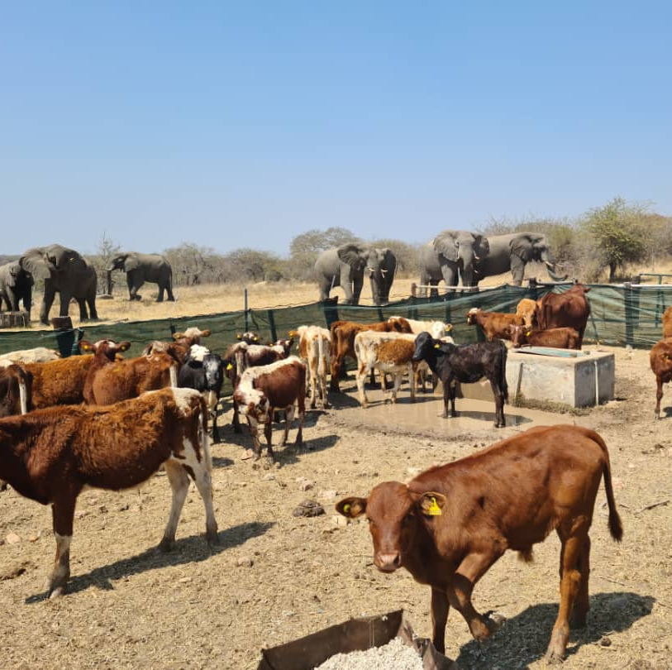
IFAD K’Lusa Project
The Inclusive red meat value chains for women and youth farmers in Eastern and Southern Africa project (K’lusa), is a 3 year project being implemented in two countries Zimbabwe and Malawi.
This project has been funded by the International Fund for Agricultural Development (IFAD).
The project is being implemented by a consortium of 3 partners, led by the International Livestock Research Institute (ILRI), and composed of Solidaridad Southern Africa and the Global Roundtable for Sustainable Beef (GRSB).

Slide 3
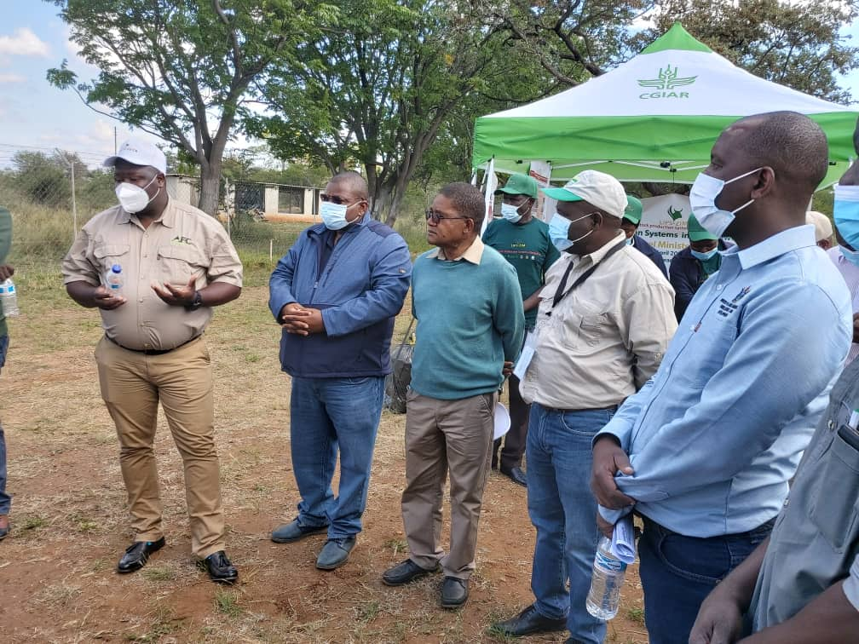
The project's overall objective is to develop sustainable, inclusive and transformative red meat value chains in the most vulnerable smallholder farming communities of Eastern and Southern Africa.
The project will facilitate an increased meaningful participation in the livestock sector by women and youth to enhance their livelihoods through positive economic impacts and increased nutrition security in rural communities.
The project is working with the Southern Africa Regional Roundtable for Sustainable to implement in Zimbabwe and Malawi.

Slide 4
The following are the key focus areas that the Roundtable could focus on alongside the project activities. This is both in Malawi and Zimbabwe in the project sites;
• Consumer Awareness- meat grading
• Producer awareness –Animal production
• Animal welfare education
• Develop Marketing strategies for Small Holder Farmers

Slide 5
Other Items
Board now meeting more frequently.
Looking at Country Boards.
East Africa Still on the table.
Funding options

