Slide 1
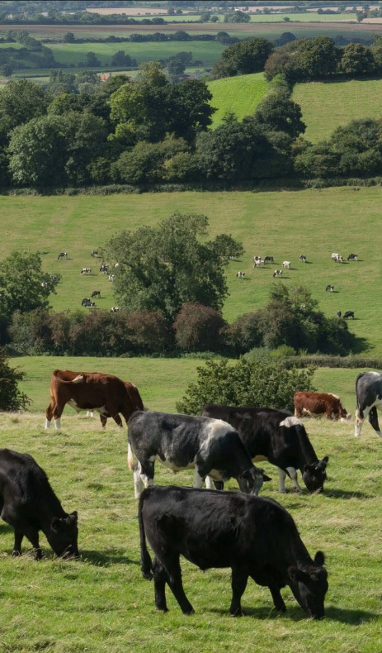
Nature Positive Production
Key takeaways from the last meeting (May 8)
High-level summary of feedback received in last few weeks
To discuss:
- Conversion
- Movement from expectations to recommendations
- Representing the regional contexts
- What does this mean for non-RT members?
Timeline and next steps
Any other business
June 27, 2024

Slide 2
Why should we consider a deforestation statement?
Key takeaways from the last meeting
The science shows that new deforestation is not necessary to beef production.
It supports our legitimacy + reputation around deforestation (including at global events).
Our history is born out of a focus on deforestation.
It’s part of our Principles & Criteria already (as of 2014)
Native forests are protected from deforestation.
Grasslands, other native ecosystems, and high conservation value areas are protected from land conversion and degradation.
It supports coalescing for the industry around meeting the European Union Deforestation Regulation.
Many of our members already have own commitments/targets on deforestation.
Roundtables don’t necessarily have deforestation as a focus in their NPP goals.

Slide 3
2024 GRSB Deforestation Survey
Deforestation and Conversion Commitments
50% have a deforestation commitment
Half of surveyed members already have public deforestation commitments in place.
Every retailer and majority of processors had a deforestation commitment.
50% do not have a current public deforestation commitment.
1 producer / association has a commitment:
protecting native trees while removing invasive brush where feasible.
1
2
1.1
Zero Deforestation
1.2
Conversion Included?
47% (8/17) included conversion.
Only 1 member had a commitment on deforestation but not conversion.
53% (9/17) were zero deforestation.
Processors, retailers, NGOs, and 1 RT.
Answered: 28
Skipped: 14

Slide 4
Key takeaways from the last meeting
2024 GRSB Deforestation Survey
Geographic Coverage of Current Commitments
Brazilian Amazon and Cerrado biomes
Global
Cerrado is more apt to refer to conversion.
Some members have adopted deforestation commitments applicable to their entire global supply chains.
Latin America
Other
Several members have commitments covering Argentina, Mexico, Paraguay, and Bolivia.
Australia and the United States.
Answered: 14
Skipped: 28

Slide 5
Key takeaways from the last meeting
Definitions on forests
Forest definition | Focus | Canopy cover | Vegetation height | Extension
AFi | Allows legitimate national or sub-national definitions | 10 % | 5 meters | 0.5 hectares
SBTi SBTN EUDR FAO | Does not allow legitimate national or sub-national definitions | 10 % | 5 meters | 0.5 hectares
AFi definition of forest: Land spanning more than 0.5 hectares with trees higher than 5 metres and a canopy cover of more than 10%, or trees able to reach these thresholds in situ. It does not include land that is predominantly under agricultural or other land use . Forest includes natural forests and tree plantations. For the purpose of implementing no-deforestation supply chains, the focus is on preventing the conversion of natural forests.
Note: Quantitative thresholds (eg, for tree height or canopy cover) established in legitimate national or sub-national forest definitions may take precedence over the generic thresholds in this definition.

Slide 6
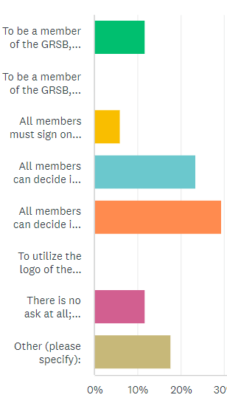
What is the ask for this statement?
Key takeaways from the last meeting
Directionally, it seems like members want to opt-in for signing onto the statement
but those who opt out have to present an action plan on deforestation
To be a member of the GRSB, you must have an aligned public commitment.
To be a member of the GRSB, you must have an aligned internal commitment.
All members must sign onto the statement to keep membership status (mandatory).
All members can decide if they want to sign on publicly to the statement (opt-in).
All members can decide if they want to sign on publicly to the statement (opt-in) AND if members do not publicly sign on, they are required to create an action plan around addressing deforestation.
To utilize the logo of the GRSB or mention that you are a member of the GRSB, you must have an aligned public position on deforestation.
There is no ask at all; this is just directional.
Other: 2 depends on content and 1 align with the Consumer Goods Forum FPC Beef WG (deforestation and conversion free, aiming by 2025)
Answered: 17
Skipped: 26

Slide 7
Definitions and language
Define terms like "natural" and "native" forests. Specify differences between old-growth (primary) and regenerated (secondary) forests.
Suggestion: stick with primary forests, over native forests, due to AFi alignment. Call our regenerated / secondary forests somehow.
Deforestation and conversion
Separate deforestation and conversion into two statements
Keep conversion ; remove conversion
Emphasize legality – illegal deforestation as the focus
Suggestion: reference conversion but have the focus be on deforestation and circle back to conversion. Include additional emphasis on some regional contexts and how their focus will be on legality-only due to continued challenges – and that the industry has worked for decades on this, to provide recognition for the work
Traceability
Keep traceability ; remove traceability – debate on necessity (if no deforestation issues) and costs
Suggestion: reference traceability as one option towards demonstrating protection of forests but that there are other options as well
Considerations on local realities
Call out more explicitly regional realities and the economic pressures on producers ; that this work needs to be part of a multi-pronged approach
Achievable implementation & collaborative tone
The statement should avoid prescriptive language; balance recommendations with member capabilities and local realities; while emphasizing ambitious, nature-positive goal
Monitoring and impact
Be clearer on how we’re going to monitor progress – or not; include mechanisms for monitoring and ensuring local level impact delivery
(2) Feedback received since then

Slide 8
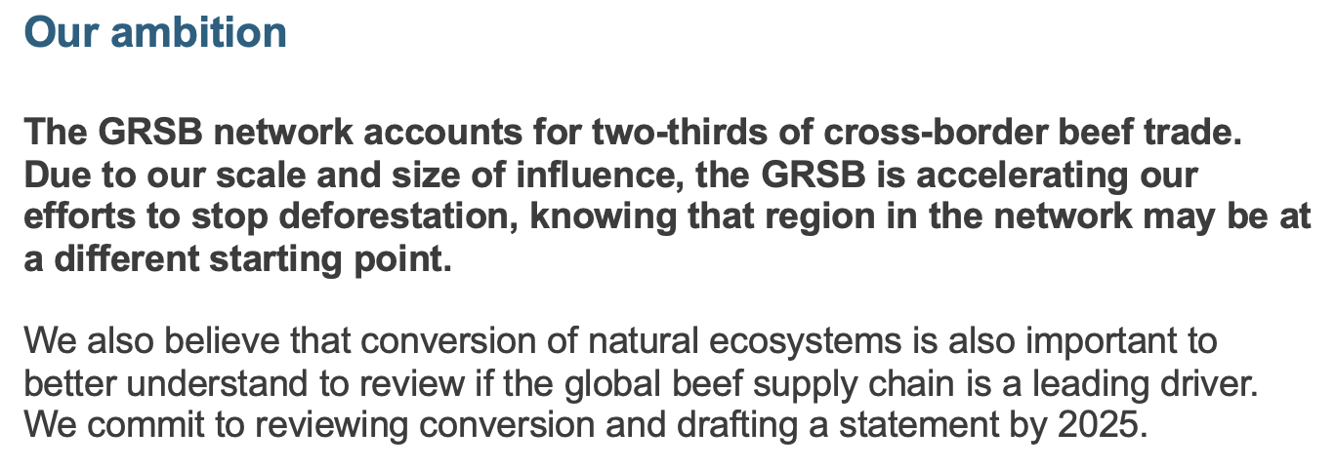
Webinar around conversion in July
(3) Key discussion points
Conversion
Previous Draft:
Current Revised Draft Version:

Slide 9
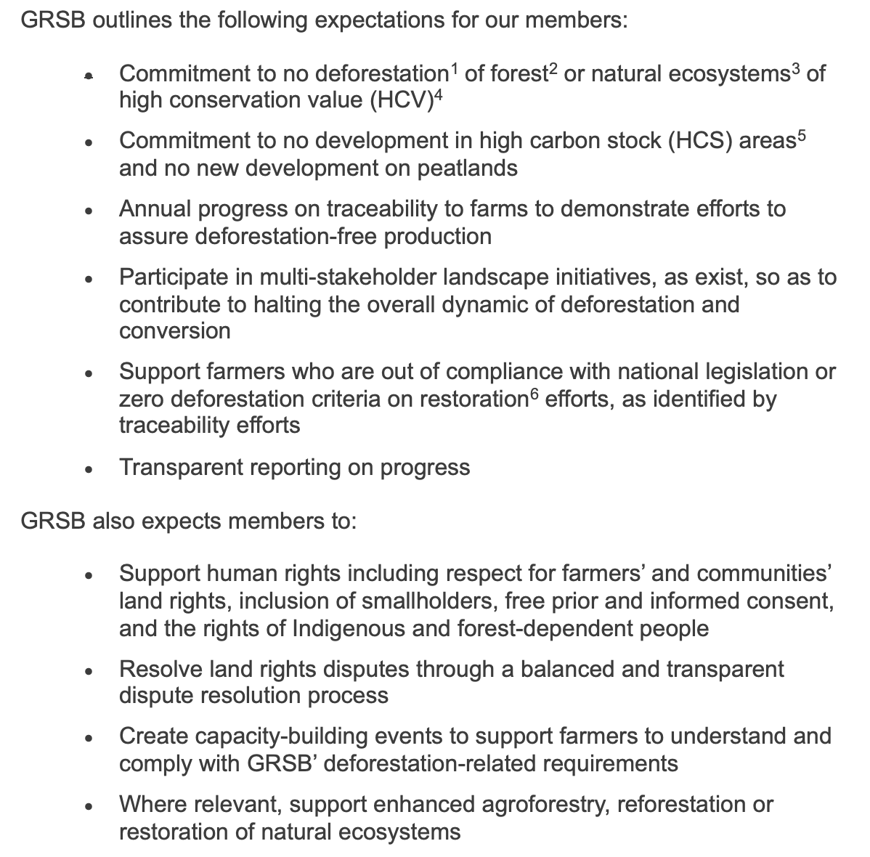
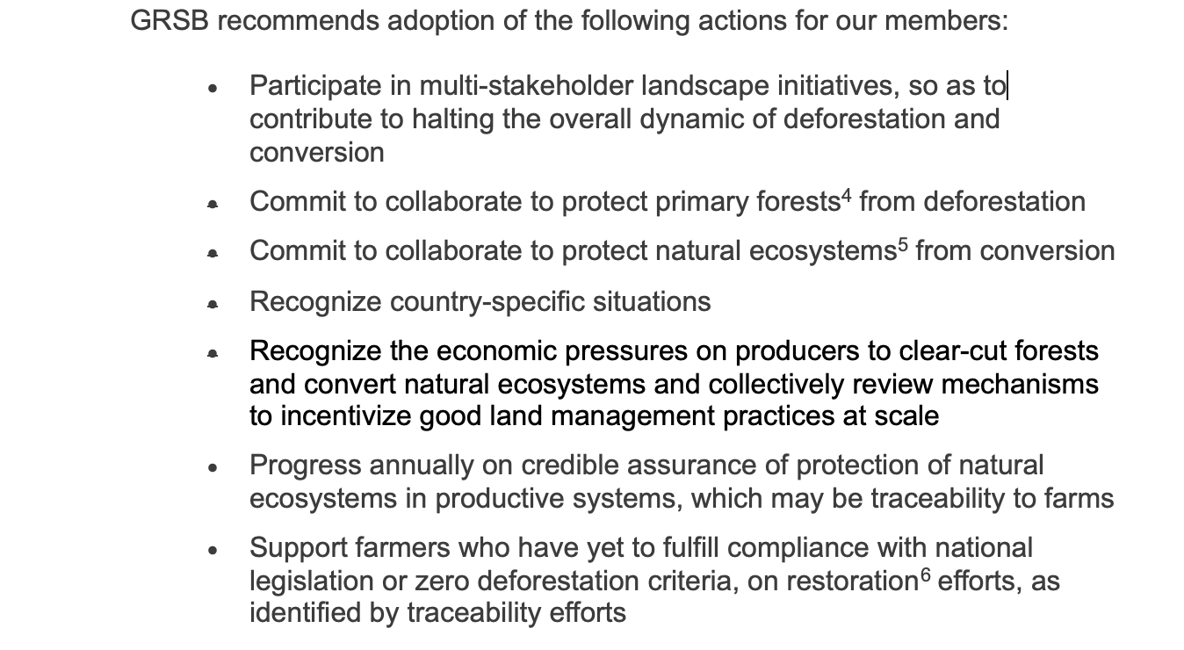
Expectations to Recommendations
(3) Key discussion points
Previous Draft:
Current Revised Draft Version:

Slide 10
Representing the regional and local realities
Suggestion (in conversations) on a one-pager for each RT
Challenges
Land use challenges in the local context
Is forest loss relevant in your country?
Is biodiversity or natural ecosystems loss relevant in your country?
If any are applicable, what are the key drivers?
Legislation
Natural ecosystems or forest-related legislation
Roundtable plan and need for support
What actions are you all working on as a roundtable around land use change?
What do you call on the GRSB network to support you on, in regards to land use change?
Definitions
This is how we define forest.
This is how we define deforestation.
This is how we define conversion.
More information
Something we wish people know about our local context, in regard to land use change.
Producer feature.
More information can be found X.
(3) Key discussion points

Slide 11
(3) Key discussion points
What about non-RT members?
Direct link to RT answers to: What do you call on the GRSB network to support you on, in regards to land use change?
Support RT members on their work on land use change
Active engagement in RT discussions around land use change
Financial incentivization
Technical assistance
Provision of traceability tools
Capacity-building
Other ideas?

Slide 12
Draft timeline & next steps:
Review revised position statement through July 10
Let us know if you need additional time – please send timelines
Concept: work towards voting on statement mid-July – running up to conference, will need to align on:
- How to support RTs in vocalizing their local contexts
- Expectations of non-RT GRSB members
- Working towards action plans in RTs around land use change
Thank you in advance for your perspectives.

